Slide 1
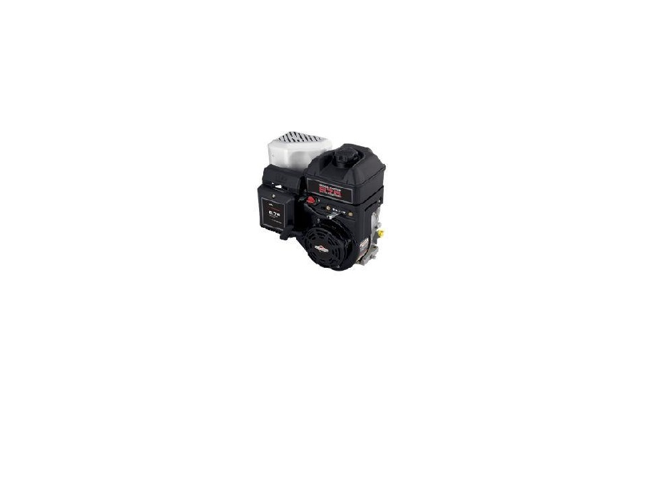
Power and Energy 3201 Parts Catalog
Tyler, Nathan, Zach and Jordan
206cc Briggs and Stratton 875 INTEK Series Engine
Model:120000

Slide 2
Air Filter Assembly

Slide 3
Back Plate

Slide 4
Back Plate Air Hose

Slide 5
Heat Shield

Slide 6
Muffler and Gasket

Slide 7
Recoil Starter

Slide 8
Speed Control cover

Slide 9
Switch

Slide 10
Flywheel Cover

Slide 11
Gas Tank

Slide 12
Fuel hose and Clamps

Slide 13
Carburetor

Slide 14
Governor Lever and Springs

Slide 15
Governor Plate Assembly Unit

Slide 16
Heat Shield #2

Slide 17
Oil Sensor

Slide 18
Ignition Armature

Slide 19
Flywheel Fins

Slide 20
Flywheel and Pin

Slide 21
Flywheel Nut and Cup

Slide 22
Valve Cover and Gasket

Slide 23
Cylinder Head Bolts

Slide 24
Head Gasket and Push Rods

Slide 25
Spark Plug, Valves, Valve Spring and Valve Keeper

Slide 26
Valve Assembly Plate and Gasket

Slide 27
Crankcase Gasket

Slide 28
Crank Case Gear Assembly

Slide 29
Camshaft

Slide 30
Lifters

Slide 31
Connecting Rod Cap and Oil Dipper

Slide 32
Piston and Connecting Rods and Piston Ring

Slide 33
Piston Head, Piston Pin, Piston Rod, and Piston Pin Clip

Slide 34
Crankshaft, Crankshaft Gear, and Crankshaft Spacer

